Slide 1
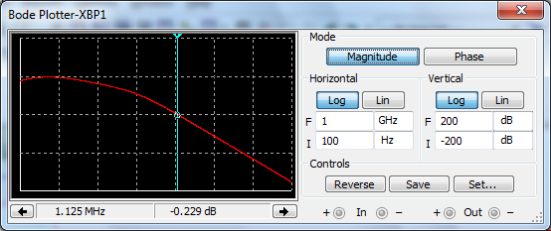
Open loop unity gain is 1.125Mhz

Slide 2
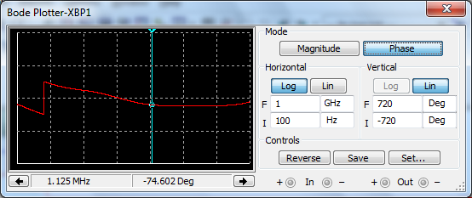
Phase is 74 degrees
Phase margin is 180-74=106 degrees

Slide 3
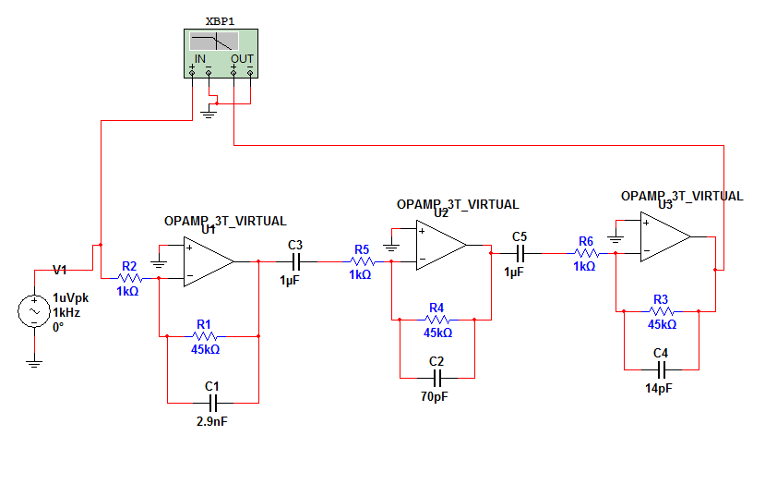
Op amp stability circuit

Slide 4
